Slide 1
Electronic Waste
(E-waste)
Notes:
Today we are celebrating Planet Ark’s National Recycling Week, this year’s theme is ‘What Goes Around Comes Around’. In today’s presentation, the do’s and don’ts recycling particular items, and what we can do in our everyday lives to ensure we can recover as many materials as possible in an easy way.

Slide 2
FIRSTLY,
Which is the fastest growing waste stream in Australia?
Plastic
Electronics
Food waste
Notes:
Before we begin, let’s have a little activity. Which type of waste is the fastest growing in Australia?
Plastics, e-products or food waste?
Note for presenter: If you are delivering this face to face, you can either ask people to raise their hand. If delivered online they can type their answers in a chat box.

Slide 3
E-WASTE
E-waste is a term used for broken electronic products close to the end of their useful life. Products with a cable cord, battery or power plug are considered e-waste.
Each Australian disposes of 20.7 kgs of
e-waste each year
Notes:
It’s e-products! AKA e-waste.
In average every year, Australians dispose of 20.7kg of e-products per person, being one of the highest in the world!

Slide 4
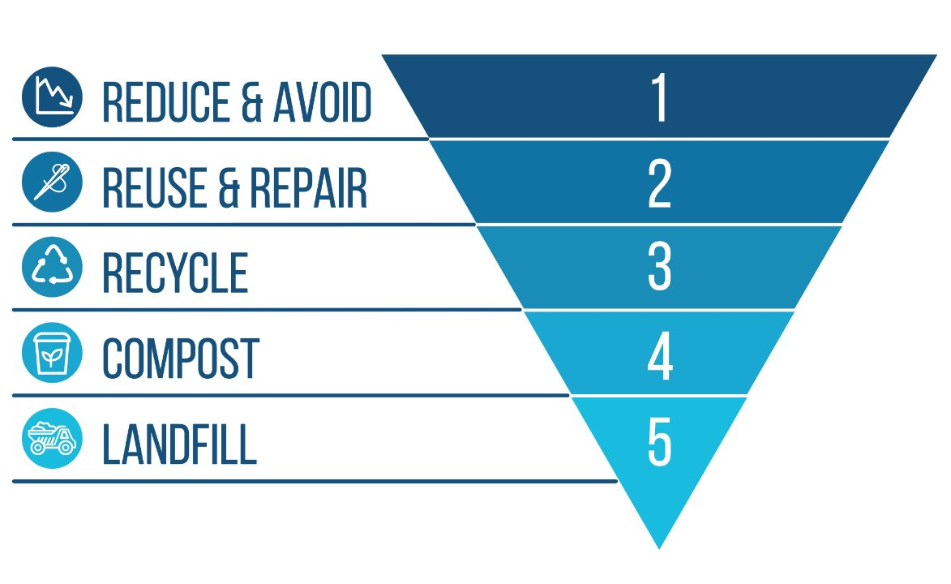
WASTE HIERARCHY
While there are recycling options for some electronics, we should always think about the waste hierarchy first and try to avoid purchasing new products when possible. Electronic manufacturers should also create durable items and avoid planned obsolescence.
Notes:
Before we continue talking about e-waste or e-products recycling,
it is important we understand the waste hierarchy, whenever we talk about waste, there are many things we should consider before recycling that have a higher environmental value.
The most desired option is to avoid or reduce the amount of waste created in the first place. For example, do you need a brand-new phone every year?
Then we have reuse and repair, consider repairing your electronics before buying a new one whenever possible.
THEN we have recycling there are many ways to recycle our old and broken electronics, with the programs being free to use for individuals.
That is followed by composting, while we cannot really compost our electronics, it is important we understand where it sits withing the waste hierarchy for other items such as packaging.
Finally, we have landfill. It is the least desired option

Slide 5
MOBILE PHONES
There are more than 23.5 million mobile phones hoarded in Australian homes. 4.2 million of them are broken phones that can be recycled. Over 95% of the materials in mobile phones can be recovered and returned to the supply chain to go back into making new products.

Slide 6
MOBILE PHONES
Recycle them at one of the 3,500 public drop-off points including all major mobile phone retailers, some local libraries, or check with your local council at RecyclingNearYou.com.au.
You can also pick up a free recycling satchel from Australia Post or order one from MobileMuster. If you'd like to use your own packaging, you can order a prepaid return label from MobileMuster and drop your package off at your local Australia Post store or post box.

Slide 7
TVs COMPUTERS & ACCESSORIES
Australians are among the highest users of new technology in the world, purchasing nearly 5 million computers every year.

Slide 8
TVs COMPUTERS & ACCESSORIES
Under the National Television and Computer Recycling Scheme, every company that makes and/or imports computers into Australia is required to pay for the end-of-life recycling of these products. That means, you can drop off your old TVs and computers for recycling for free. Visit recyclingnearyou.com.au for local options.

Slide 9
BATTERIES
Batteries can cause fires and explosions at landfills and sorting facilities. This includes batteries in laptops, mobile phones, power tools, cars and cameras. Recycling batteries keeps toxic materials out of landfill where they can contaminate the soil and groundwater.

Slide 10
BATTERIES
Rechargeable batteries are a great way to reduce battery waste.
When recycling, look for participating retailers to recycle batteries from home.
For workplaces consider investing in a box from Batteries 4 Planet Ark.
Always tape dead battery ends when storing dropping off for recycling

Slide 11
RECYCLING E-WASTE
Printer Cartridges
Printer cartridges are not e-waste but are used in an electronic product.
They are made up of a complex mix of plastics, metal, inks and toners which represent a significant investment in resources. When they are disposed of into landfill these resources are lost.

Slide 12
RECYCLING E-WASTE
Printer Cartridges
Recycling cartridges ensures the ink is recovered for artists, and toner and plastic are used for road base. You can recycle them for free through the Cartridges 4 Planet Ark program.
Recycle your printer cartridges by dropping them off at participating retailers, or order a free Cartridges 4 Planet Ark box for your workplace.

Slide 13
GET STARTED!
Before buying a new electronic product, consider sourcing a second-hand item.
Before recycling, consider repairing your item, donating or reselling your item to the manufacturer to be used as spare parts.
Visit recyclingnearyou.com.au to find your closet drop-off locations for all electronic items and accessories, as well as services available from your local council.
Notes:
These are the things you can do to get involved this National Recycling Week.

Slide 14
JOIN THE CYCLE!
Join over 12,300 people in engaged workplaces by registering your workshop or event at:
nationalrecyclingweek.com.au
And share to our socials!
@planetark
#NRW
Notes:
Help Planet Ark by spreading the word on socials, and registering your workplace!
Visit Recycling Near You to discover what other items besides packaging you can recycle.
Check out if there are any events in your area to celebrate National Recycling Week.

