Slide 1
Recycling Packaging
Notes:
Today we are celebrating Planet Ark’s National Recycling Week, this year’s theme is ‘What Goes Around Comes Around’. In today’s presentation, the do’s and don’ts recycling particular items, and what we can do in our everyday lives to ensure we can recover as many materials as possible in an easy way.

Slide 2
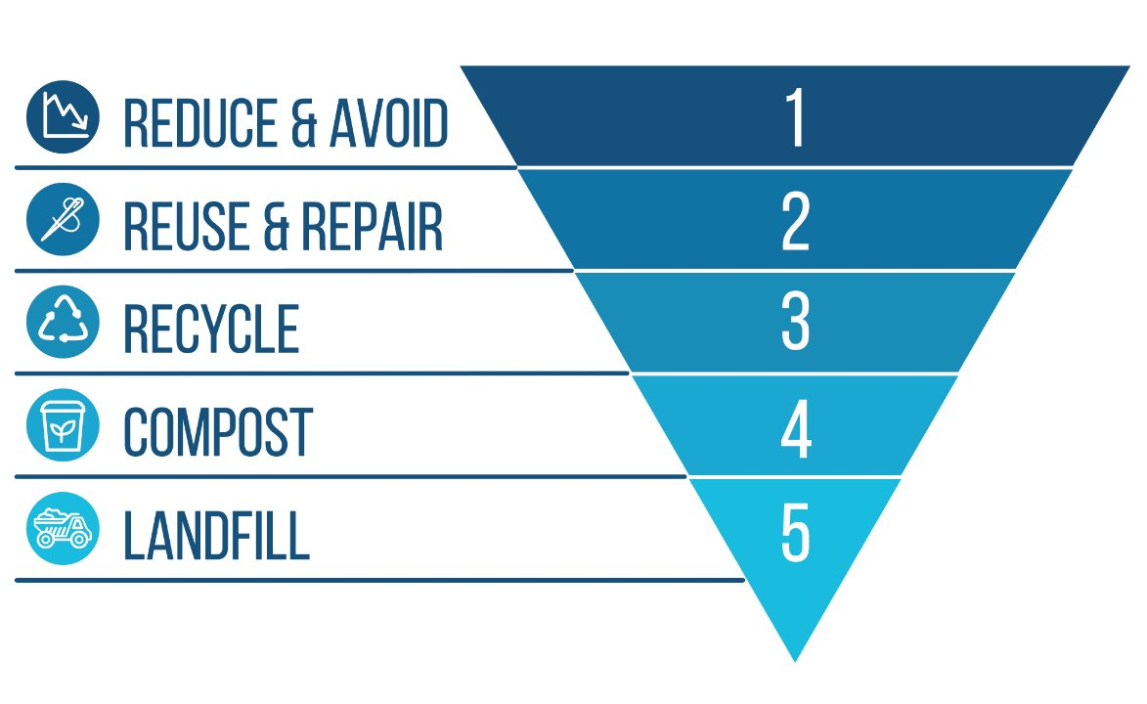
WASTE HIERARCHY
When thinking about waste management, considering the waste hierarchy is a great way to identify which efforts may have a better outcome. The first thing we should focus on is avoiding creating waste when possible, then reducing, reusing, recycling
Notes:
Before we begin, it is important we understand the waste hierarchy, whenever we talk about waste, there are many things we should consider before recycling that have a higher environmental value.
The most desired option is to avoid or reduce the amount of waste created in the first place. For example, do you need a bag to carry just a few items? Or avoid using any straws and simply sip your beverages?
Then we have reuse, use reusable packaging any chance you get, things like reusable coffee cups, or BYO containers to the deli. You can also repurpose many items like glass jars.
THEN we have recycling or composting, it is important that we only recycle packaging that is actually recyclable, we’ll talk about this later on, but not all packaging can be recycled and if we place some of these into the recycling bin, they will only cause contamination.
Same for compostable packaging, only compost certified compostable packaging through services that accept them, otherwise they will be deemed as contamination and sent to landfill. Check with your local council regarding their ability to accept these items in FOGO (Food Organics Garden Organics collection) or through other services.
Note that plastic compostable packaging should not go in your recycling bin.
Waste to energy is a way to deal with items that are not currently recyclable, this is not a clean energy source, but it is still better than sending material to landfill.
Finally, we have landfill. It is the least desired option

Slide 3
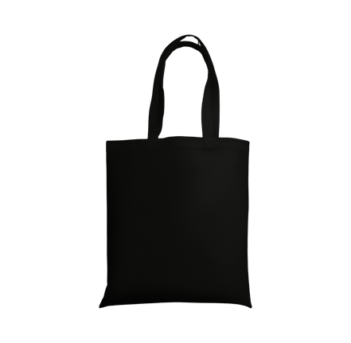
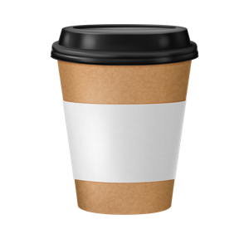
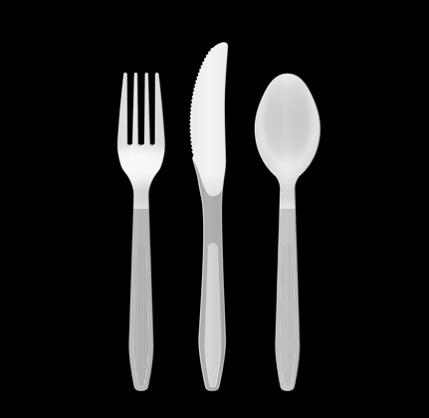
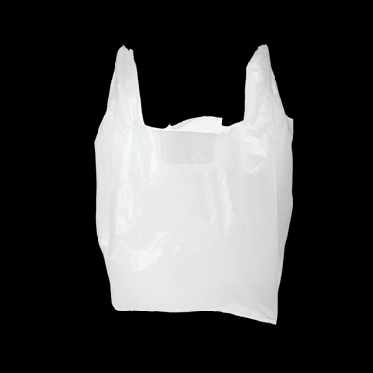
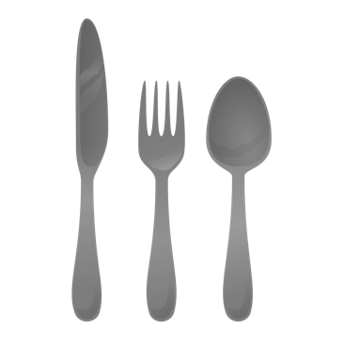
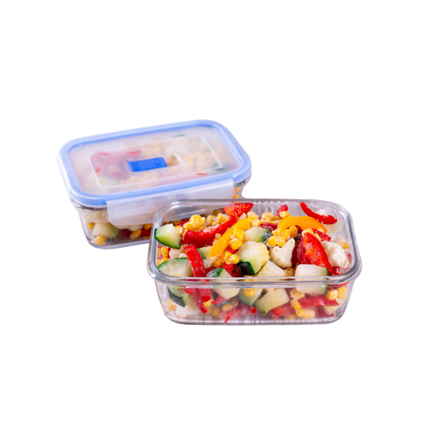
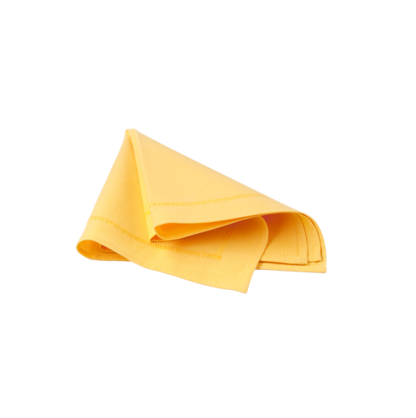
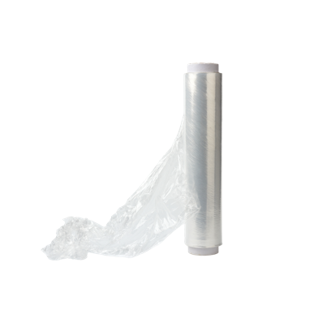
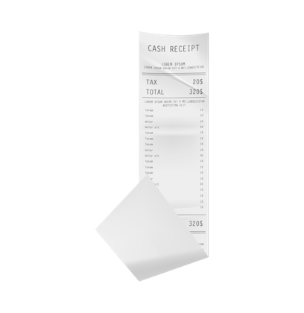
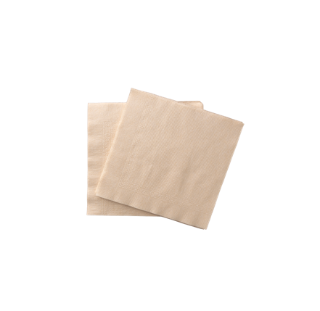
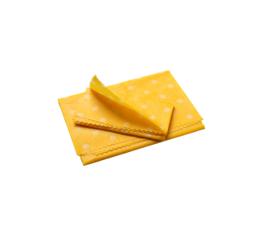
REDUCE AND REUSE
Start with simple changes, swap non-recyclable items for reusable ones
Nothing, or an
e-copy
Notes:
So, let’s start with reduce and reuse, here are some items that are not easily recyclable that have reusable alternatives:
Coffee cups are not accepted by most councils, there are some programs that can recycle them, however you need to drop them off at participating locations. These items are easily avoided by using your own reusable cup
Cutlery and chopsticks: These are not recyclable due to their shape, if you place them in the recycling bin, they will be considered a contaminant and will end up in landfill anyway. Better to use reusable items. You don’t need a fancy set, you can build your own from items from op shops.
Napkins: Even though they are paper, they are not recyclable (although they can be composted at home or in the FOGO bin if your council allows it) this is because they are contaminated with food and oils (from when you wipe your mouth), but even if they were completely clean, the paper fibres in napkins are too short and do not hold themselves if they are recycled (you need longer fibres)
Plastic bags are one of the main contaminants in our recycling bins. While large scale recycling of soft plastic is on pause, check with your local council for alternative recycling options. Better to avoid them altogether and use reusable alternatives.
Cling wrap is not recyclable. It is better to use other reusable items such as beeswax wraps or silicone bags.
Receipts- they are technically recyclable, however most of them contain BPAs an endocrine disruptor chemical which can be transferred to the paper when it is recycled, it is a ‘forever chemical’ meaning that it will stay in products for a very long time. If possible, avoid them if you don’t need them.

Slide 4
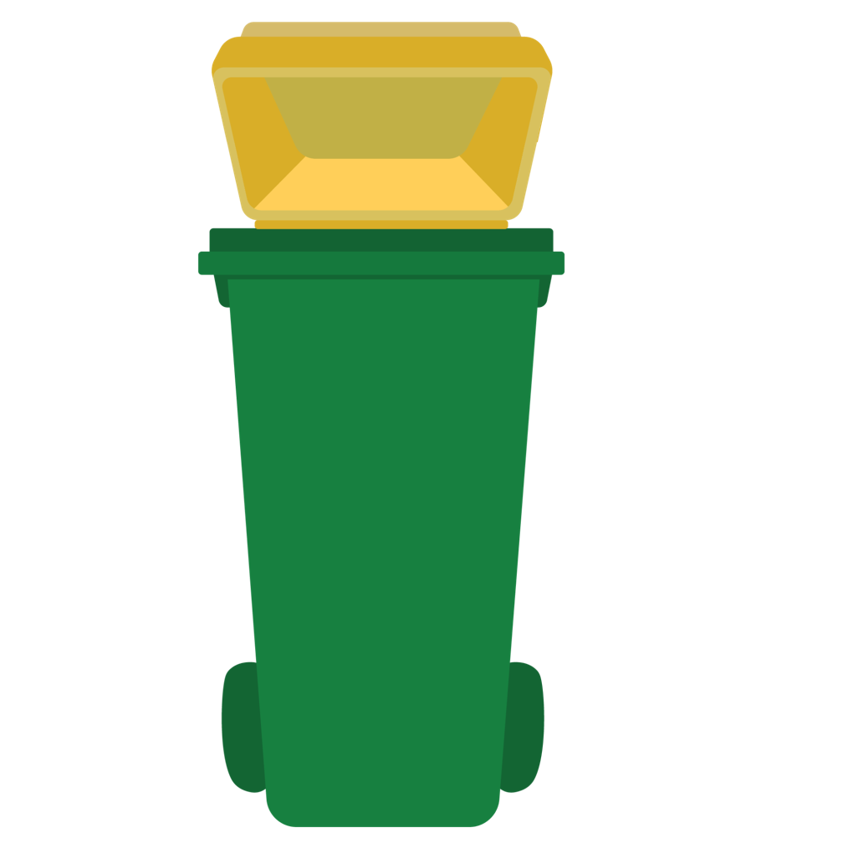
RECYCLING AT HOME
The recycling bin at home is for packaging from the kitchen, bathroom and laundry, plus paper and cardboard.
Items like toys, polystyrene foam, clothing, glassware, hangers or home décor should never go in the recycling bin. They will be sent to landfill, and have the potential to contaminate recyclables, which would then also be send to landfill.

Slide 5
RECYCLING AT HOME
Recycling at home is a service provided by your local council, which is why bins and accepted items vary around the country. The easiest way to understand what can and can not you in your bins is finding your council on recyclingnearyou.coom.au .
You will also find information about alternative recycling points, or drop-off recycling there.

Slide 6
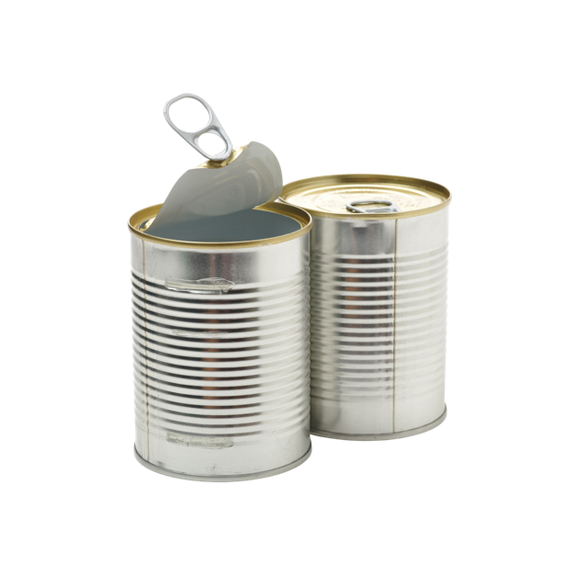
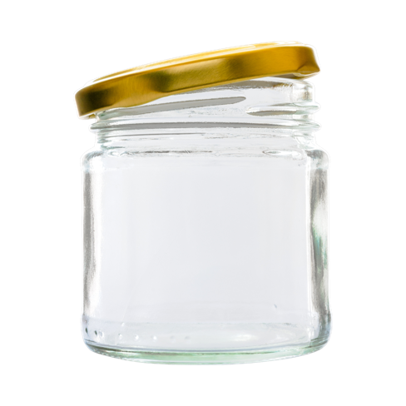
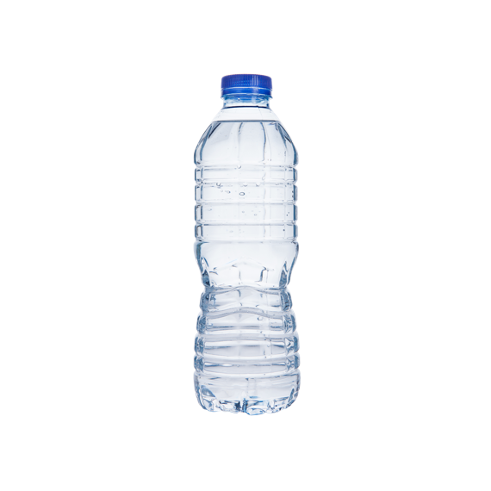
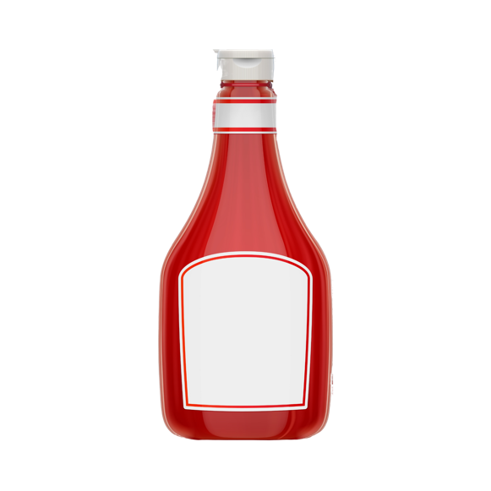
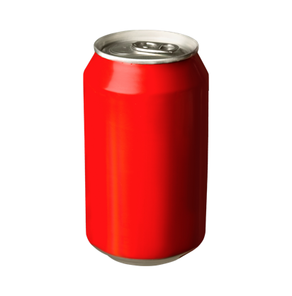
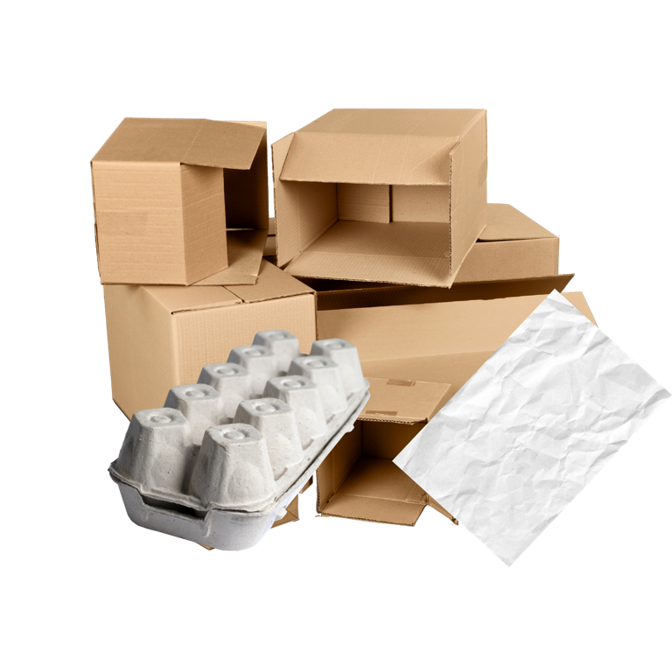
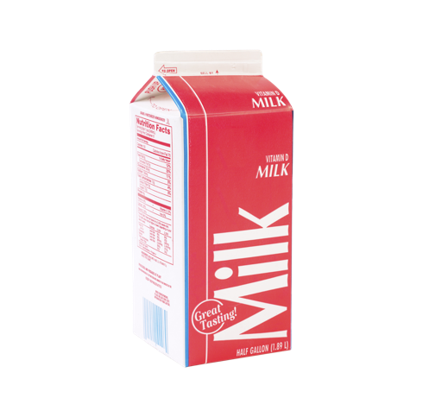
GENERALLY ACCEPTED
Hard Plastic bottles or containers
Glass Jars
Cans
Cartons*
*in some areas
Paper and Cardboard
Notes:
Our recycling bins at home are designed for most rigid packaging and paper items, they also need to be placed in loose, don’t put them inside a bag.

Slide 7
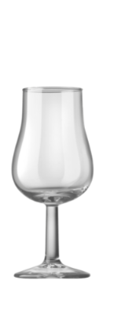
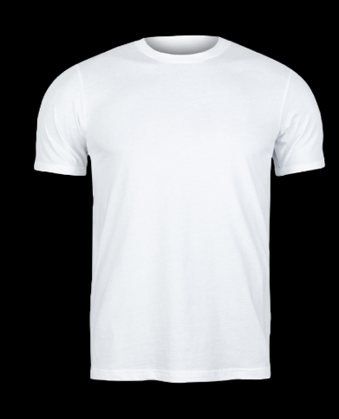
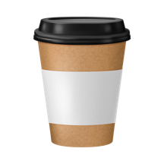
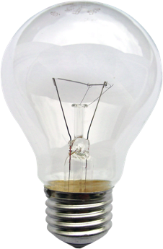
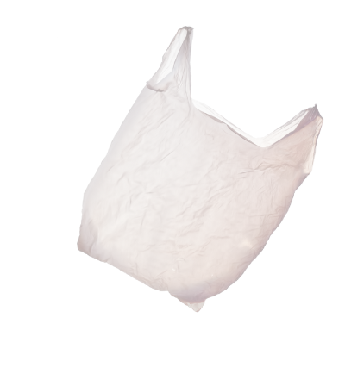
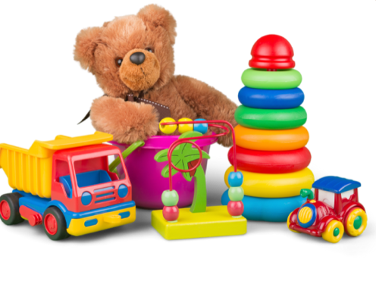
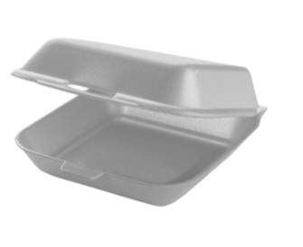
GENERALLY NOT ACCEPTED
Drinking glasses, light bulbs, mirrors
Coffee cups
Clothing or textiles
Toys
Styrofoam
Soft Plastics
Notes:
Items that are not rigid packaging or paper, should never go in your recycling bin, things like toys, plastic bags, hangers and ceramics shouldn’t go in there.

Slide 8
RECYCLING LABELS
Recycling labels can be confusing.
Plastic Identification codes (PICs), are often confused with recycling symbols.

Slide 9
"RECYCLING" LABELS
Do these labels tell you the item is recyclable?
Yes
No
Notes:
Let’s have a little activity, when you see a number inside a triangle, does it mean your packaging is recyclable?
Note for presenter: If you are delivering this face to face, you can either ask people to raise their hand if they think this is correct or not. If it is delivered online, they can type their answers in a chat box.

Slide 10
RECYCLING LABELS
These symbols are called PICs, or plastic identification codes. They do not refer to an items recyclability.
No
Notes:
It doesn’t!
The plastic inside triangles only tells you the type of polymer an item is made of. There are many things that affect the recyclability of an item, it is not only about the material it is made of, but also its shape and dimensions, weight, inks, glues and colourants!

Slide 11
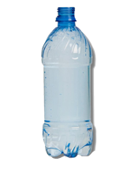
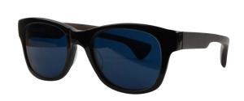
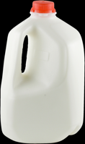
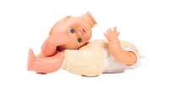
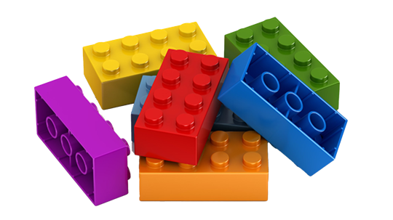
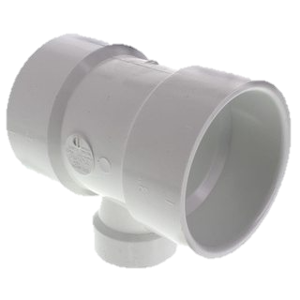
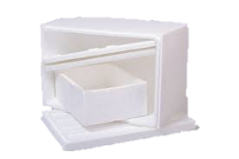
PICS
(PET) Polyethyene Terephthalate
(LDPE) Low-Density Polyethylene
Other plastics
(HDPE) High-Density Polyethylene
(PP) Polypropylene
(PVC) Polyvinyl Chloride
(PS) Polystyrene

Slide 12
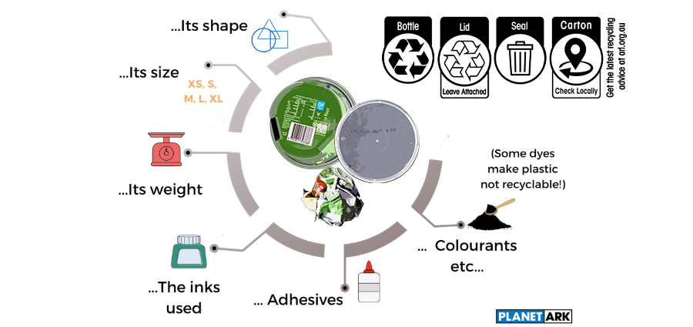
RECYCLABILITY
There are many factors that affect the recyclability, such as:

Slide 13
ARL
The ARL is the only evidence-based system that provides you with easy-to-understand recycling information on the packaging. Look for it so you know which bin your packaging goes in.
Notes:
Thankfully, in Australia, we have an evidence-based label for packaging. The Australasian Recycling Label or ARL takes into account all of those variables and assesses how a piece of packaging will behave at the sorting and recycling facilities.
But we know that technical recyclability is not enough, especially when different councils have different rules, so it also takes into account the percentage of the population who can recycle these materials through their council.
Provided it is technically recyclable, if more than 80% of the population can recycle a material through their council, it will be classified as recyclable; between 60-80% it will be conditionally recyclable and have an instruction telling you to check with your local council, and finally less than 60% of the population, it will be classified as not recyclable.

Slide 14
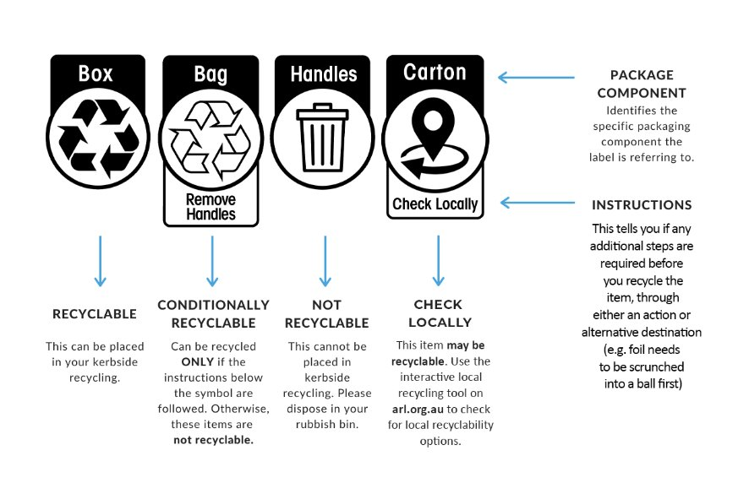
ARL
Notes:
This is how it works:
All the components of your packaging should have a label that tells you what to do with it.
The opaque or coloured recycling symbol means that that component of your packaging can be recycled as is, just chuck it in the recycling bin.
The clear recycling symbol can only be recycled if the instructions underneath are followed, if you don’t it needs to go in the rubbish bin.
And finally, the bin symbol, unfortunately that piece of packaging is not recyclable, and it needs to go in the rubbish.

Slide 15
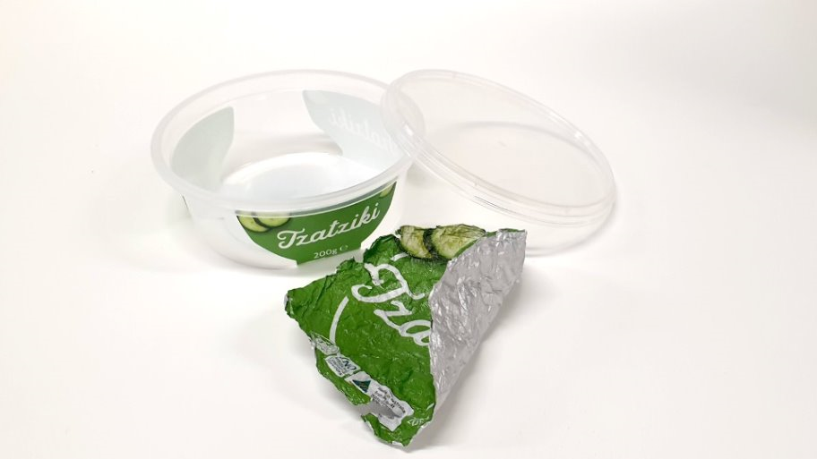
USING THE ARL
Which bin would you put these items on?
Notes:
Let’s have another activity. How would you dispose of these items?
This is a rigid plastic tub, with a plastic lid and aluminium foil
Note for presenter: If you are delivering this face to face, you can either get a volunteer to tell you how they would dispose of this, and/or have different people from the audience answering how they would dispose of these. If it is delivered online, they can type their answers in a chat box.

Slide 16
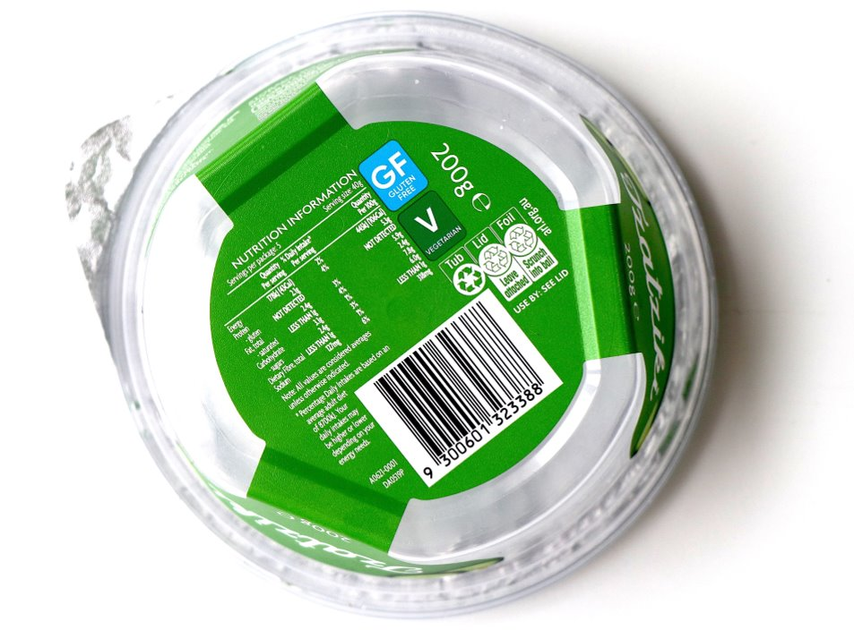
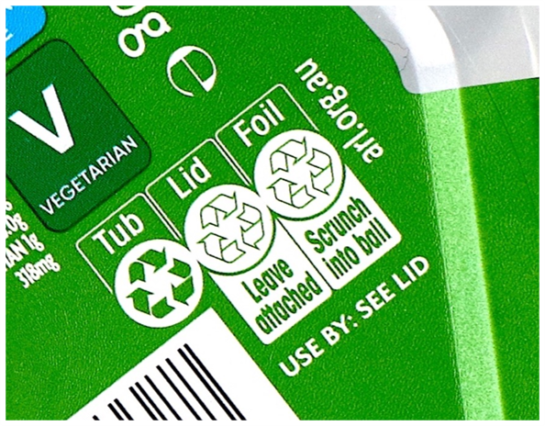
USING THE ARL
How did you go?
Notes:
This is the ARL that you’d find in this piece of packaging, the tub is recyclable, the lid can be recycled if it is attached back into the container (this is because the lid might be too light, 2D items get sorted with the paper stream, by attaching it back to the container it becomes part of the larger item and can travel to the plastic streams) and finally the foil needs to be scrunched into a ball. Same as the lid it needs to be in a 3D shape so that it can get sorted properly (alfoil needs to be the size of a golf ball or larger)

Slide 17
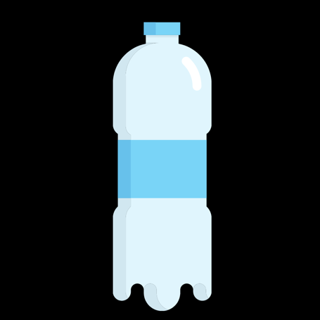
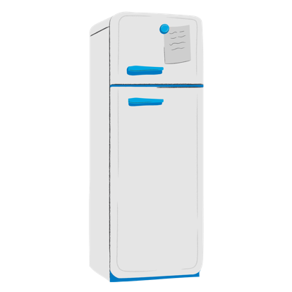
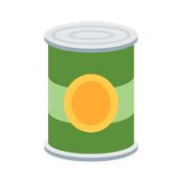
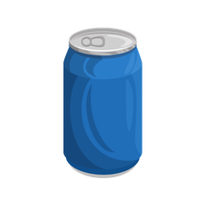
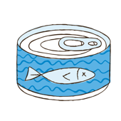
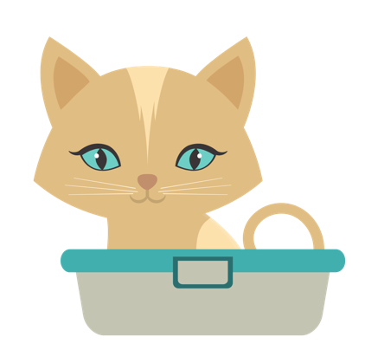
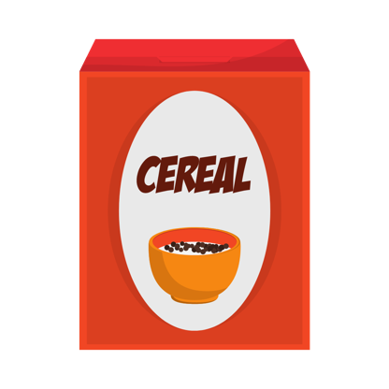
RECYCLED PRODUCTS
PLASTIC BOTTLE
STEEL CAN
ALUMINIUM CAN
Fridge parts
&
new cans
New bottles
Planes & new cans
NEWSPAPER
CARDBOARD BOX
Cat litter
New boxes
Notes:
What are your recyclables turned into?
Plastic bottles can be turned into new bottles, check your packaging to see if it has any ‘recycled materials’
Steel cans can be turned into more cans or made into parts for fridges.
Aluminium cans are turned into more cans or become parts of airplanes or cars.
Newspaper is great for making cat litter
And finally, cardboard is turned again into new cardboard items.

Slide 18
COMMON RECYCLING MISTAKES
1
4
NON- RECYCLABLE PLASTICS
SOFT PLASTICS
5
2
POLYSTYRENE FOAM
BAGGED RECYCLABLES
3
6
FOOD / ORGANICS
CLOTHING/ NAPPIES
Notes:
Now that you know what can be placed in your recycling bin, let’s talk about what shouldn’t go in there and are the most common mistakes.
As mentioned before, soft plastics are the number 1 contaminant in our recycling bins. They cause major issues at the sorting facilities and will get discarded into landfill. Consider reusing soft plastic bags at the supermarket for fruit and vegetables by keeping them with your reusable shopping bags.
Recyclables inside a bag. This is because when items arrive at the materials recovery facility (MRF), each individual item needs to be sorted, if they are all inside a bag, due to safety issues and material volumes, it is not possible to take the items out from the bag, so the whole thing is discarded to landfill.
Food and organics also contaminate our recycling bins, they can create health issues if the food rots and make all paper items non-recyclable.
As mentioned previously plastic items that are not packaging are not recyclable, items like hangers, toys should never go in.
Anything made from polystyrene foam is also a no go

Slide 19
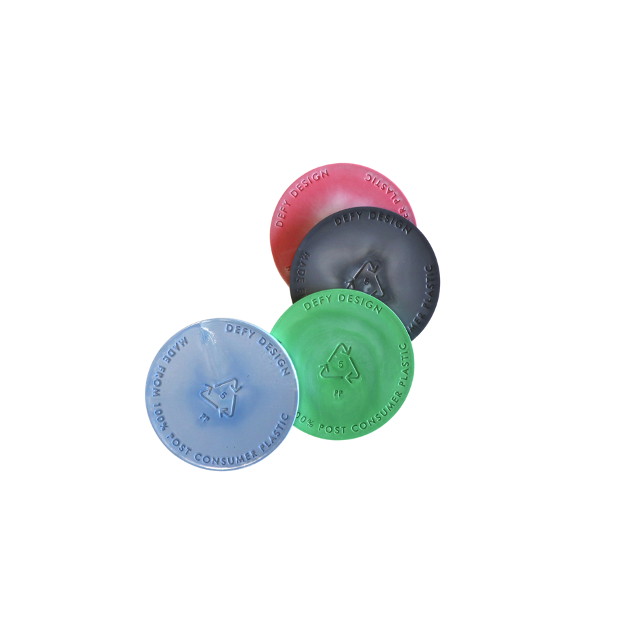
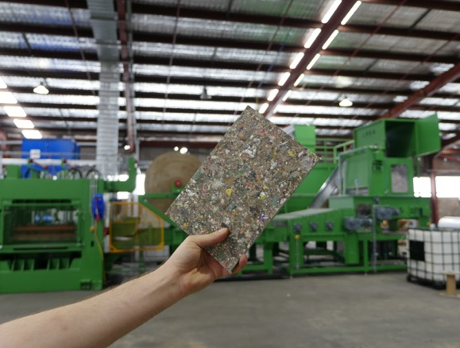
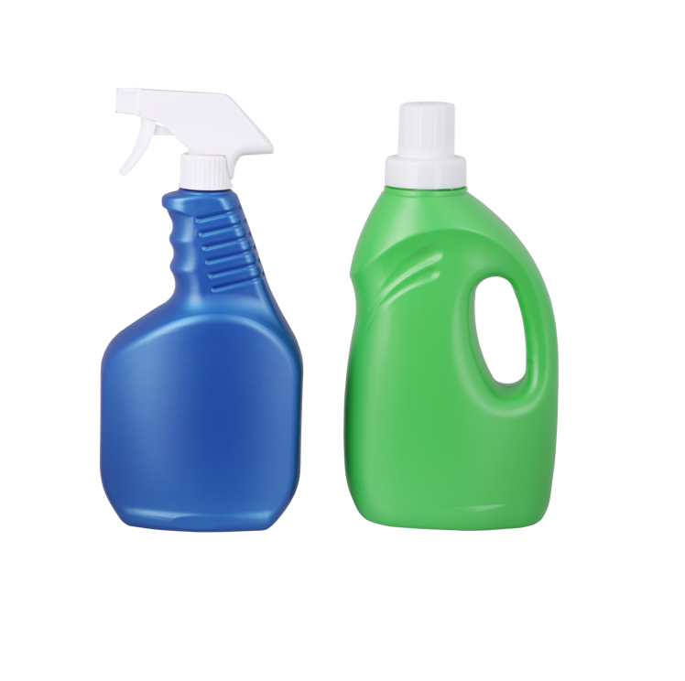
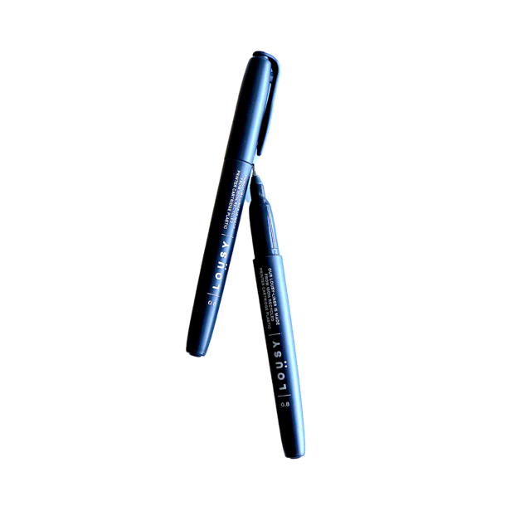
BUY RECYCLED
True recycling occurs when items that you’ve put in your recycling bin or dropped off at a collection point are turned into new materials. Recycling only works when products made from recycled materials are purchased by consumers, businesses and governments.
Packaging made from recycled plastics
Lousy Ink pens made from recycled ink from printer cartridges
Coasters made from recycled plastics
SaveBOARD – sustainable building materials made from packaging waste
Notes:
True recycling occurs when items that you’ve put in your recycling bin or dropped off at a collection point are turned into new materials. In fact, recycling only works when products made from recycled materials are purchased by consumers, businesses and governments.
This creates a circle of supply and demand and supports Australian jobs in the recycling and manufacturing industries. Items made from recycled materials generally communicate that on their labels, next time you are in the shops, have a look to see if your favourite brands are using them!

Slide 20
RECYCLABLE AND RECYCLED
What’s the difference?
RECYCLABLE
RECYCLED
Can be collected, sorted and turned into new items.
An item made from
‘recyclable' materials.
What to look for:
What to look for:
MADE with
'x' % recycled materials.
Notes:
Recyclable packaging is packaging that can be collected, sorted, sold and turned into new items, to know if you can recycle your packaging remember to always check the Australasian Recycling Label to know which bin to put it in.
Recycled packaging is packaging that is made from materials that have previously been used, recovered, collected, sorted and turned into new items. Always look for claims on packaging saying “Made with x% of recycled materials” or “Made with x% of recycled content”

Slide 21
ALTERNATIVE DROP-OFF LOCATIONS
Just because you can’t recycle something at home, doesn’t mean it can’t be recycled. There are many items that can be recycled if you take them to drop-off points.

Slide 22
ALTERNATIVE DROP-OFF LOCATIONS
HOUSEHOLD
E-WASTE
OTHER
Mattresses
Cartridges
Stationery
Coffee capsules
Mobiles
Bread tags
Chemicals & Paint
Batteries
Personal care
Clothing & Linen
Light globes
Beauty care
Computers & Accessories
Construction & Demolition
Blister packs
Visit RecyclingNearYou.com.au
Notes:
Household items like mattresses can be picked up by your local council or recyclers, just make sure you book a collection, otherwise they will be sent to landfill. Coffee capsules, clothing and linen can also be taken to drop off points, a quick trip to the shopping centre should give you access to most of these options.
Same for e-waste, you can drop off many electronics at participating stores, most of them will accept all of it so that you don’t have to make multiple trips.
Finally, there are other ‘personal care’ items that can be recycled such as make up packaging, blister packs etc…
Visit Recyclingnearyou.com.au to find out how you can recycle most of these items.

Slide 23
JOIN THE CYCLE!
Join over 12,300 people in engaged workplaces by registering your workshop or event at:
nationalrecyclingweek.com.au
And share to our socials!
@planetark
#NRW
Notes:
Help Planet Ark spread the word and share your great work place initiatives by sharing and tagging Planet Ark.

